Slide 1
Hull Identification Number (HIN)
Validation & Verification Guidelines
Prepared in cooperation with the National Association of State Boating Law Administrators Vessel Identification Registration and Titling Committee
Updated September 24, 2020

Slide 2
Table of Contents
Slide 3: Why is the HIN Important?
Slide 4 – 6: HIN Background
Slide 7 – 9: Previous HIN Formats
Slide 10 – 14: Current HIN Format
Slide 15 – 18: Homemade, Kit, and Imported Boats
Slide 19 – 20: Commercial Boats
Slide 21: Vessel Inspections
Slide 22 – 24: Incorrect HIN Format Policies
Slide 25 – 26: State Assigned HINs
Slide 27: Legacy HINs
Slide 28: Other Assigned HINs
Slide 29 – 32: HIN Flow Charts
Slide 33: Examples of HIN
Slide 34: Key Takeaways
Slide 35: USCG Contact Information

Slide 3
Background
Why is the HIN important? A boats hull identification number (HIN) is as unique as a cars VIN or a persons social security number. Entering even one character incorrectly causes you to alter the boats identity entirely. You wouldn’t file your tax return with an incorrect social, would you?
That is why it is critical to ensure you check and double check
that the HIN you’ve entered into the system is correct.
If you mistakenly enter a number 1 instead of a letter I or L, or the letter B instead of a number 8, or the number 0 instead of a C, D, or O, you end up creating a HIN for a boat that doesn’t exist. This can create issues for the owner and the agency in the future and cause double the work and aggravation for everyone involved.
This document is designed to provide clarification for
regulation 33 CFR Subchapter S, as well as be a resource to help
states ensure that HINs are recorded accurately.

Slide 4
The Hull Identification Number (HIN)
History:
Prior to Nov. 1,1972 there were no requirements for a HIN to be assigned to recreational boats. Manufacturers used mostly serial numbers that were unique to that manufacturer, but had no prescribed format beyond that specific manufacturer.
Nov. 1,1972 The U.S. Coast Guard required all manufacturers to affix a 12 character HIN on all domestic and imported recreational boats per 33 CFR §181
Purpose/Use:
The HIN is the primary means for identifying boats that are subject to recalls
Used by states for registration and titling
Used by USCG for documentation
Used by law enforcement to identify and recover stolen vessels
Used by the Dept. of Homeland Security for a host of national security reasons

Slide 5
33 CFR Part 181…(Recreational Vessels Only)
§181.23 Hull identification number required
A manufacturer must identify each boat produced or imported with a primary and duplicate hull identification number permanently affixed in accordance with §181.29.
A person who builds or imports a boat for his or her own use and not for the purposes of sale must obtain the required hull identification number in accordance with the requirements of the issuing authority listed in 33 CFR part 173, Appendix A for that boat’s state of principal operation and permanently affix the HIN to the boat in accordance with §181.29 of this subpart.
No person may assign the same HIN to more than one boat.
§181.27 Information displayed near HIN:
With the exception of the characters “US-”, which constitute the country of origin code for the United States, if information is displayed within 2 inches of the HIN, that information must be separated from the HIN by means of borders or must be on a separate label so that it will not be interpreted as part of the HIN

Slide 6
33 CFR Part 181…(Recreational Vessels Only)
§181.29 Hull Identification Number Display
Two identical HINs are required to be displayed on each boat hull
The primary HIN must be affixed in accordance with §181.29(a)
The duplicate HIN must be affixed in an unexposed location on the interior of the boat or beneath a fitting or item of hardware
This duplicate HIN has been required since the 1984 regulatory update to HIN formats and may be used to replicate the primary HIN in the case that the primary HIN is missing. Email HINIssue@uscg.mil for more information.
Each HIN must be carved, burned, stamped, embossed, molded, bonded or otherwise permanently affixed to the hull so that alteration, removal, or replacement would be obvious. If the number is on a separate plate, the plate must be fastened in such a manner that its removal would cause some scarring of or damage to the surrounding hull area.
A HIN must not be attached to parts of the boat that are removable and the characters must be no less than one-fourth of an inch high

Slide 7
HIN Formats
Since November 1, 1972 there have been three HIN formats:
Straight Year Format (Used November 1, 1972– July 31, 1984)
Model Year Format (Used November 1, 1972– July 31, 1984)
Current Format (Used exclusively August 1, 1984 to present)
Each format consisted of the same three components in the order below:
A Manufacturer(s) Identification Code (MIC)
A 5-digit serial number assigned by the manufacturer
A 4-digit alpha-numeric code that represents the boats date of production and model year

Slide 8
Straight Year Format

Slide 9
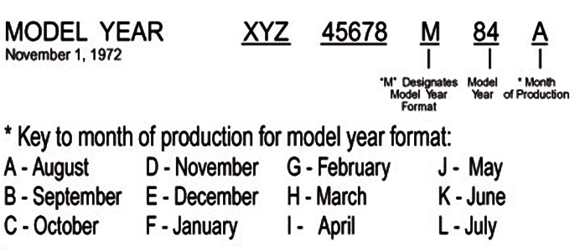
Model Year Format

Slide 10
§181.25 Current HIN Format
Characters 1-3:
Manufacturer(s) Identification Code (MIC), assigned by the U.S. Coast Guard and primarily exists of a series of 3 letters. However, on a rare occasion, the USCG has issued MICs that include numbers, although this practice was discontinued in mid-1990s. Examples of valid MICs with numbers include 4WN, BL2, etc…
A MIC may be reassigned if the manufacturer assigned to it has been out of business for 10 or more years.
States are required to verify the MIC for accuracy against the USCG MIC Website found here: http://uscgboating.org/content/manufacturers-identification.php
ABC
EXAMPLE:

Slide 11
§181.25 Current HIN Format
Characters 4-8:
Must be a serial number assigned by the manufacturer and may include letters and/or numbers, with the exception of the letters I, O, and Q, which cannot be used in this portion of the HIN due to similarities to numbers.
ABC34567
EXAMPLE:

Slide 12
§181.25 Current HIN Format
Characters 9-12: contain the production date and model year of vessel.
9: Must be a letter value to represent month hull was built: A = January, B = February, etc….
10: A number value indicating the last digit of the year of production, i.e. 9 represents 2019 (33 CFR 181.25(c) - The date indicated can be no earlier than the date the construction or assembly began and no later than the date the boat leaves the place of manufacture or assembly, or is imported into the US for sale.)
11-12: Indicate the last two digits of the model year or year it was offered for sale by the manufacturer
The HIN must consist of 12 characters uninterrupted by slashes, hyphens, or spaces.
ABC34567H920
EXAMPLE:

Slide 13
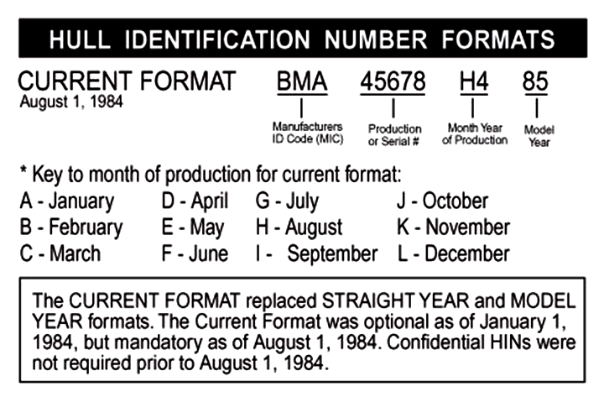
Current HIN Format

Slide 14
MIC Information and Verification
§181.31 Manufacturer(s) Identification Code (MIC) Assignment
Each person (manufacturer) required by §181.23 to affix HINs must request a Manufacturer(s) Identification Code in writing from the USCG Commandant.
For boats manufactured outside of the jurisdiction of the United States, a U.S. importer must obtain a Manufacturer(s) Identification Code. The request must indicate the importer’s name and U.S. address along with a list of the manufacturers, their addresses and the general types and sizes of boats that will be imported.
If a nation has a hull identification number system which has been accepted by the Coast Guard for the purpose of importing boats, it may be used by the importer instead of the one specified within this subpart.
States should verify the MIC for accuracy
against the USCG MIC Website found here: http://uscgboating.org/content/manufacturers-identification.php

Slide 15
Boats Affected by Federal Regulations
Homemade Boats
Kit Boats
All recreational vessels imported or manufactured after November 1, 1972
SPECIAL NOTE: 33 CFR 181.23(b) - A person who manufactures or imports a boat for his or her own use and not for sale must obtain the required State Assigned hull identification number in accordance with the requirements of the issuing authority listed in 33 CFR part 173, Appendix A for the boat’s state of principal operation and permanently affix the HIN to the boat in accordance with §181.29

Slide 16
What is a Homemade Boat?
Homemade/Backyard Built Boat
A single boat (not more than 1 per year) built with raw materials by a person or persons for personal use only and not made for the purpose of building boats for sale. Nor can it be used for commercial purposes.
This boat requires a state assigned HIN in the Current Format
SPECIAL NOTE: Some manufacturers are in the practice of selling non-compliant recreational boats to persons and calling them “homemade” by giving the new owner a materials list. Be aware of these practices. These boats will NOT have Certification Labels nor will they have USCG Maximum Capacities established! THESE BOATS ARE UNSAFE AND SHOULD NOT BE ALLOWED IN RECREATIONAL SERVICE!

Slide 17
What is a Kit Boat?
Kit Boat
A kit boat is a boat in which the buyer purchases plans to build the boat and the materials to complete the boat are supplied by the manufacturer/seller. THIS IS NOT A HOMEMADE BOAT!
This boat requires a HIN to be provided by the manufacturer/seller.
All kit boats imported or manufactured after Nov. 1, 1972 must comply with all U.S. Coast Guard Minimum Safety Standards (33 CFR Part 183) where applicable.
For additional information on Kit Boats, please see the following Boating Safety Circulars:
Issue 85, page 3: Kit Boat Manufacturers and Coast Guard Safety Standards and Regulations
Issue 87, page 3: Kit Boat Manufacturers and Coast Guard Safety Standards and Regulations

Slide 18
Imported Boats
Imported boats fall into two categories:
Boats imported for resale are done so by a U.S. importer or U.S. subsidiary that has been issued a MIC from the U.S. Coast Guard. The importer is responsible for all recall issues on these boats as well as ensuring the HIN is placed on the boat correctly.
A single boat imported by an individual for their own personal use. This boat requires a state assigned HIN in the Current Format from the state in which the boat will be principally operated. It’s important to verify that the owner is using this vessel for personal use and not acting as an importer.
SPECIAL NOTE: Foreign countries use different MICs from the US MIC database- always verify the MIC matches the manufacturer in the US database when a boat is imported. If the MIC does not match, do NOT issue a state assigned HIN and email HINIssue@uscg.mil for further direction.

Slide 19
Commercial Boats
All persons engaged in the registration of boats and validation/issuance of HINs shall be aware that the U.S. Coast Guard does not issue MICs to manufacturers of non-recreational boats.
There are manufacturers with commercial/Government divisions that have MICs; however, these manufacturers build their products to all U.S. Coast Guard Standards in 33 CFR Part 183.
In the past, some manufacturers have gained state assigned HINs en masse, labeled their products as “Commercial Use Only” and sold them to the public via a network of dealers. This is a deceptive practice. States are PROHIBITED from issuing state assigned HINs en masse to manufacturers.
UNDER NO CIRCUMSTANCES CAN A STATE ISSUE A STATE ASSIGNED HIN TO A COMMERCIAL VESSEL NOT BUILT TO RECREATIONAL VESSEL CONSTRUCTION STANDARDS.

Slide 20
Commercial Boats
There are a number of manufacturers that produce a line of boats that they label as “Commercial Use Only”. In reality, there is usually no practical commercial use for these boats. The majority are rigged for hunting/fishing and all fail to meet certification, maximum capacities, and flotation requirements. Some will come with a HIN that has a USCG issued MIC as the first three characters. The Coast Guard views these as non-compliant recreational boats and will revoke the USCG issued MIC of any manufacturer engaging in this practice.
These boats are prohibited by law for use in commercial fishing or carrying passengers for hire on the navigable waters subject to the jurisdiction of the United States!
For any questions relating to Commercial vessels, email HINIssue@uscg.mil

Slide 21
Vessel Inspections
33 CFR 174.16 – As of Jan 1, 2017- before taking any action to issue, renew, or update ownership information for a certificate of number relating to a vessel imported or manufactured on or after November 1, 1972, the issuing authority must determine whether the vessel has a primary HIN meeting the requirements of 33 CFR Part 181, subpart C.
The following methods can be used to verify the HIN:
Pencil tracing
Photographs
A physical inspection by a state official (includes HIN, make, model, year, hull material, propulsion, length, and boat registration number)
Signed affidavit by the owner attesting to the accuracy of the HIN
Contact the manufacturer (if in business to verify HIN)
Checking the USCG MIC Website: http://uscgboating.org/content/manufacturers-identification.php to confirm the validity of the MIC
NICB: National Insurance Crime Bureau database (used by law enforcement to locate secondary HINs)
NOTE: This inspection is to verify vessel information, NOT to determine seaworthiness.
For additional resources pertaining to this provision, please see: www.nasbla.org/advocacy/vessel-ID-registration/sns

Slide 22
12 Character HIN with Incorrect Format
When the state encounters a discrepancy within a 12 Character HIN on a boat within 10 years from the date of manufacture:
If the manufacturer is still in business:
The state issuing authority should send an email to the USCG at HINissue@uscg.mil with the owner and vessel information and the USCG will contact the manufacturer and authorize the manufacturer to correct the HIN discrepancy.
The USCG will provide the state with a confirmation of the manufacturer’s actions.
If the manufacturer is out of business:
The state should issue a state-assigned HIN using the Current Format
Best Practice: When the state assigns a new HIN, the Legacy (aka original) HIN must be made a part of the boat’s record, the owner should retain a copy for their records, and a copy should be kept on the boat.

Slide 23
12-Character HIN with Incorrect Format
When the state encounters a discrepancy within a 12 Character HIN on a boat older than 10 years from the date of manufacture:
The state should:
Issue a state-assigned HIN using the Current Format.
Best Practice: When the state assigns a new HIN, the Legacy (aka original) HIN must be made a part of the boat’s record, the owner should retain a copy for their records, and a copy should be kept on the boat.

Slide 24
HIN with other than 12 Characters
When the state encounters HINs on boats within 10 years from the date of manufacture that contain any number of characters other than 12:
If the manufacturer is still in business:
The state issuing authority should send an email to the USCG at HINissue@uscg.mil with the owner and vessel information and the USCG will contact the manufacturer and authorize the manufacturer to correct the HIN discrepancy.
The USCG will provide the state with a confirmation of the manufacturer’s actions.
If the manufacturer is out of business:
The state should issue a state assigned HIN using the Current Format
Best Practice: A record of the original HIN must be made a part of the boat’s record, the owner should retain a copy for their records, and a copy should be kept on the boat.

Slide 25
State Assigned HIN
Format:
The first three characters that form the MIC are the 2-letter state designation followed by the letter Z
The middle 5 characters can be any combination of letters and numbers, to be determined by the state issuing authority, with the exception of the letters I, O, and Q
The last four characters must be the month and year the state assigned HIN is issued in the following format:
The 9th character should be the letter denotation A-L that corresponds to the month the state assigned HIN is being issued (see Slide 9)
The 10th-12th characters should be the year the state assigned HIN is issued. For example- if the state assigned HIN is issued in 2020, characters 10-12 would be 020
Examples:
2012 year built vessel inspected July 2018 in Oklahoma = OKZ12345G818
2016 year built vessel inspected November 2019 in Florida = FLZ23456K919
1979 year built vessel inspected January 2020 in Texas = TXZ34567A020

Slide 26
State Assigned HIN
Placement:
In order to comply with 33 CFR Part 174, Subpart B, state issuing authorities may be required to issue a state assigned HIN to a vessel that may have a non-compliant pre-existing HIN. To help maintain the record of the original manufacturer supplied HIN, a state assigned HIN should not cover or obstruct the previous HIN
Place state assigned HIN above, below, or directly next to original HIN
In cases where original or manufacturer supplied HIN cannot be located, refer to 33 CFR 181.29 for placement and permanency of state assigned HIN
Best Practice: Although the USCG does not require the state to issue a duplicate HIN, the best practice policy is that a secondary HIN is placed in a hidden location on the vessel
Model Year:
Model year is not a part of the state assigned HIN itself, but is required for the Certificate of Number in order to be in compliance with 33 CFR Part 174, Subpart B. Therefore, if the original model year of the vessel is unknown, the state issuing authority is to use 1111 as the model year
Please note- the model year will only be shown on the Certificate of Number and is not to be incorporated into the state assigned HIN or added to the vessel directly

Slide 27
Legacy HINs
What is a Legacy HIN?
Any hull identification number associated with a given boat that is different from what is recorded in its current registration
Why do they exist?
Primarily due to human error- either the owner of the boat interprets and/or records the HIN wrong, or a clerical error is made at the time of registration/titling/documentation.
Other reasons include manufacturer error, HIN illegible or missing entirely, state assigned HIN is issued, HIN is intentionally altered to hide identity.
Best Practice:
When a state issues a state assigned HIN or discovers a legacy HIN, the best practice policy is to add the “old” HIN (Legacy HIN) to a field on the registration record named “Previous” which would record the more recent prior HIN, and could be added to the interstate report and VIS data feed.

Slide 28
Other Assigned HINs
HQZ:
The USCG uses HQZ for the rare occasions when the USCG issues a HIN
The USCG will issue the HIN by sending a letter (US Mail and email) to the boat owner as well as to the states Boating Law Administrator (BLA). The BLA will be responsible for delivering the HIN to the appropriate registration and titling authority in the state
USZ:
The National Vessel Documentation Center (NVDC) uses USZ for the rare occasions when they issue a HIN
They should be following the same policy as the USCG by sending a letter to the boat owner as well as to the states Boating Law Administrator (BLA) with the USZ HIN. The BLA will be responsible for delivering the HIN to the appropriate registration and titling authority in the state

Slide 29
HIN Assignment Flow Charts
The following three slides can be used as a quick reference guide on issuing HINs.
You can find originals on the NASBLA Website
Nasbla.org under Advocacy – Committees –
Vessel Identification, Registration and Titling – Charges, Products & Reports
For all HIN related questions, please email HINissue@uscg.mil

Slide 30
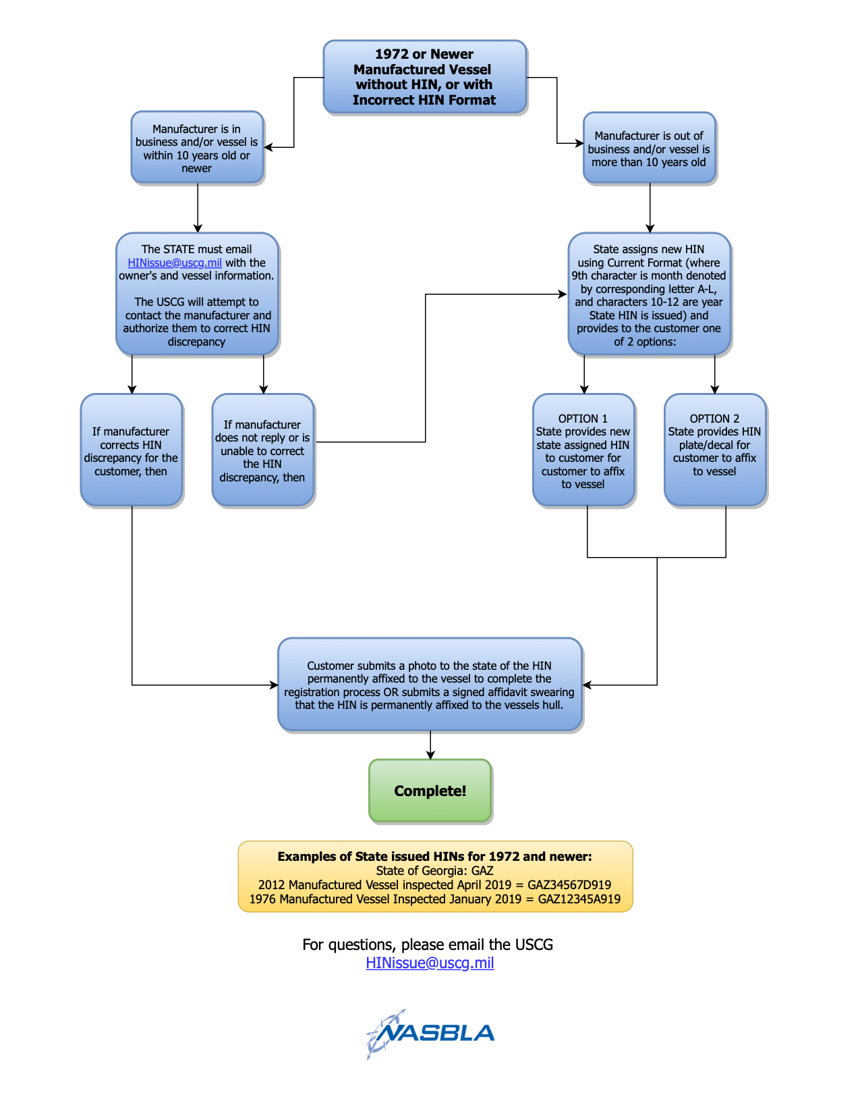

Slide 31
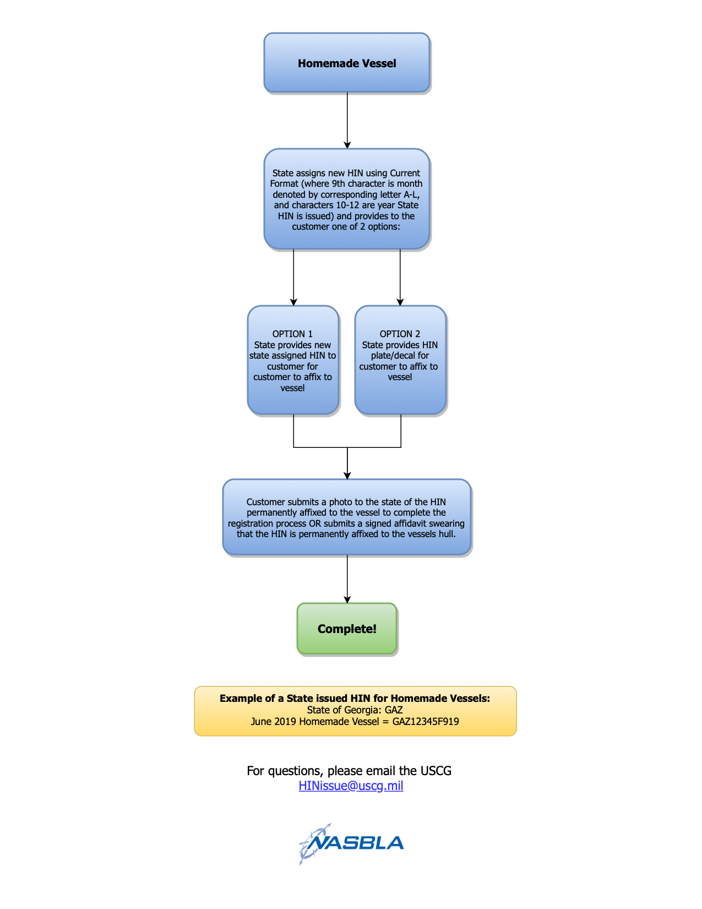

Slide 32
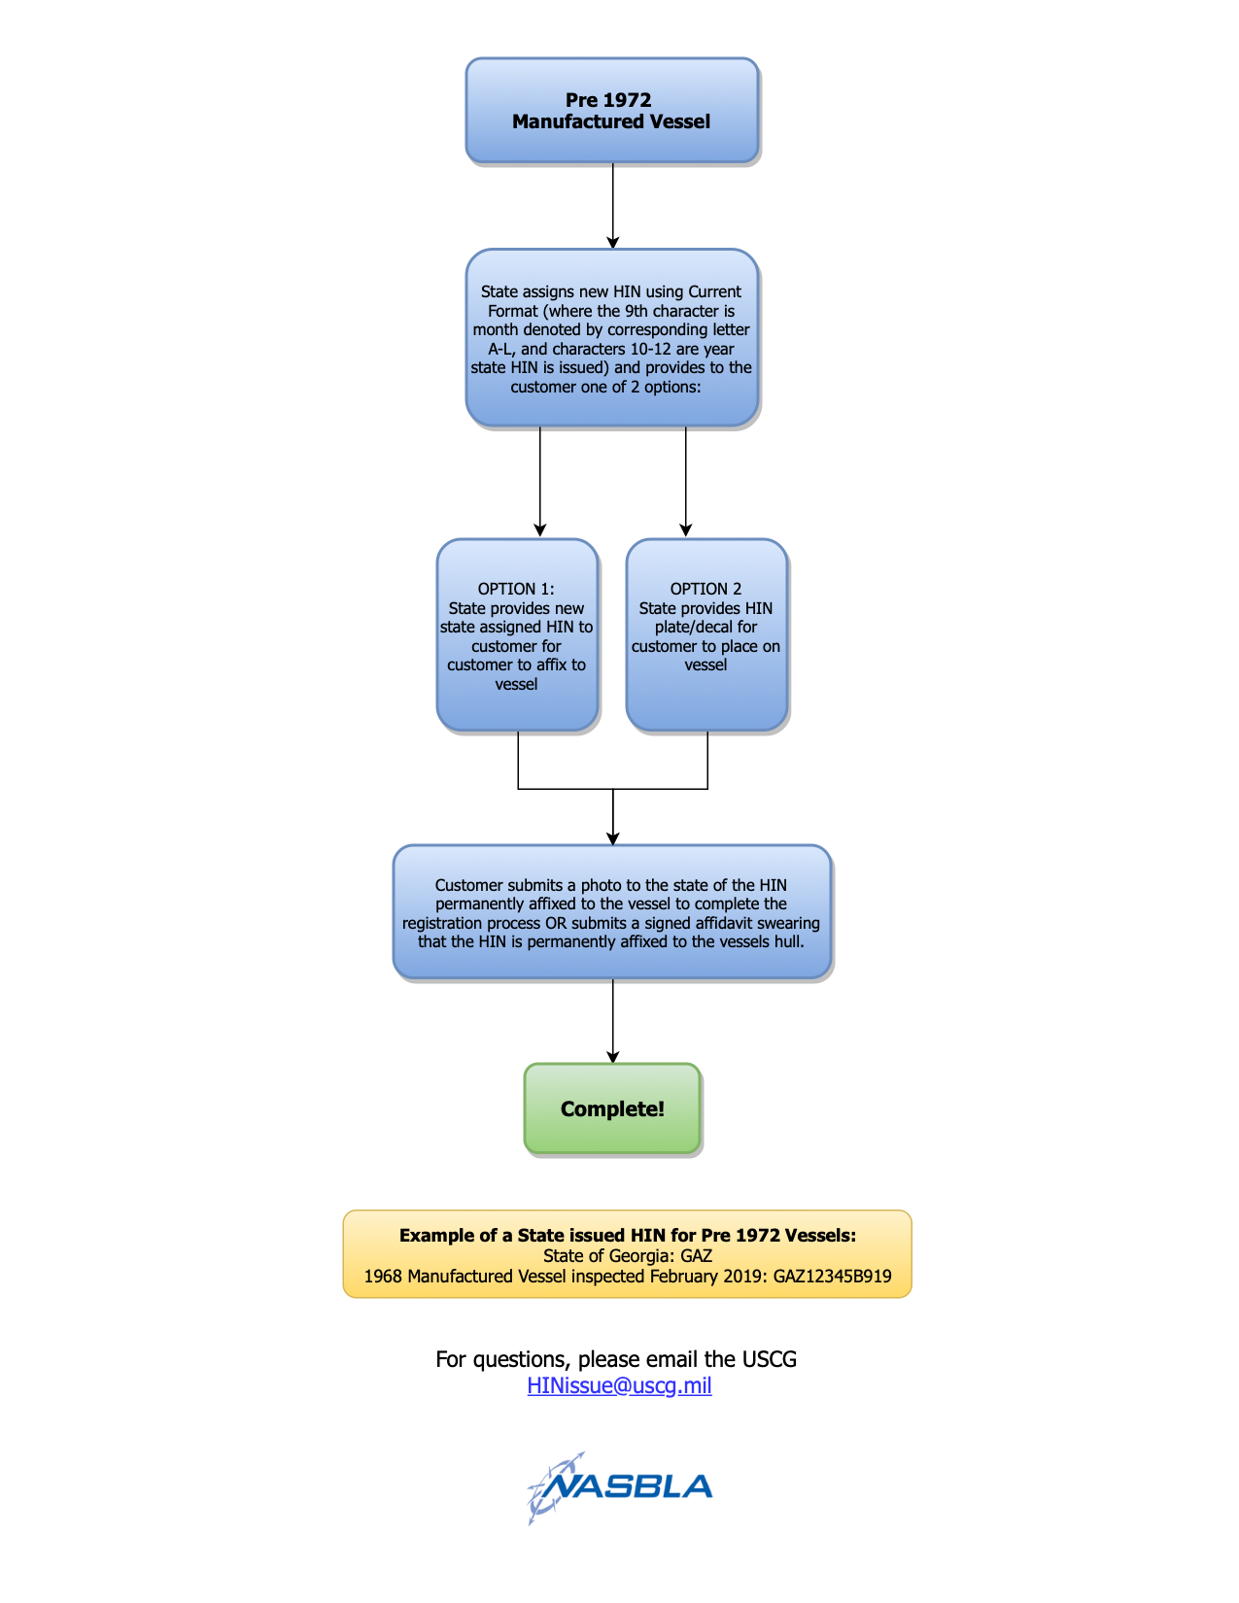

Slide 33
Examples of Good and Bad HIN Formats
WNN6532I0883 BAD – There is an I in the serial number
APB1875CZ888 BAD – The 9th character must be A-L
US-NOR17693D797 GOOD – Current format. US- designates country of manufacture (no other county code authorized)
CCMT23C50379 GOOD – Straight year format
SERM01305F213 BAD – 13 character HIN
CFZ28610L717 GOOD – State assigned HIN
4WNA3789C010 GOOD – Current format with MIC that includes a number
BAY68240M83E 2987 GOOD – Model year format. Additional characters allowed within 2 inches when separated by a border or separate label.
AZI24331A888 BAD – Uses foreign MIC – Boat is an Azimut and should have XAX as the MIC

Slide 34
Key Takeaways
All boats 1972 and newer should have a valid HIN, with boats 1984 and newer following the current format (slide 13).
States should verify the MIC for accuracy using the USCG MIC Website (slide 14).
All HINs should be inspected and verified prior to taking any action (slide 21).
If a boat does not have a valid HIN, the state issuing authority should follow the appropriate flow charts (slides 30-32) to determine how to proceed.

Slide 35
Contact the US Coast Guard
CG-BSX-23
USCG Boating Safety Division: (202) 372-1062
USCG HIN Issues: HINissue@uscg.mil

