Slide 1
Deep Dive NASBLA Course Approvals
Interactivity Option

Slide 2
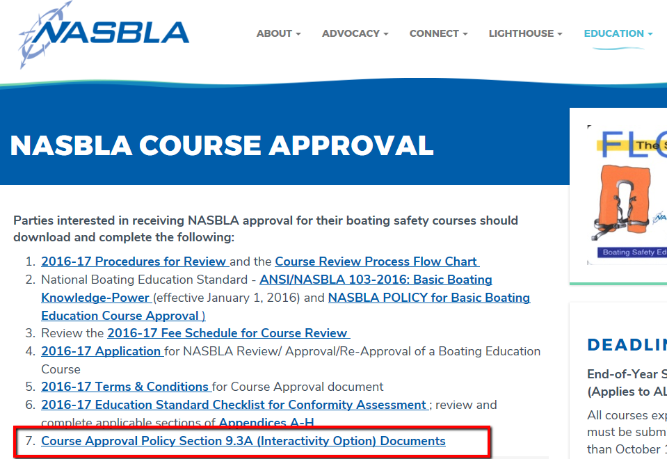
Notes:
STACEy – All details on this can be found following a link on the NASBLA Course approval page, see item 7 which opens to….

Slide 3
Notes:
Stacey - … a full web page with the rubric, worksheets, process review flow chart, references and a series of six Interactivity design tutorials to walk you through the items.

Slide 4
DEEP DIVE Session
NASBLA Course Approvals – Interactivity Rubric
Susan Stocker, Iowa BLA, Education & Outreach Committee Chair
Stacey Brown, Virginia Dept. of Game & Inland Fisheries
Amanda Perez, Boat U.S. Foundation
Edward Cossette, Kalkomey Enterprises, LLC
Mary Winkler, Kalkomey Enterprises, LLC
Katerina Douskova, Fresh Air Educators Inc.
Miranda Lee, Fresh Air Educators Inc.
Kerry Moher, Fresh Air Educators Inc.
Notes:
STACEY – We will be covering all of this and much more in …

Slide 5
NASBLA Education Policy section 9.3a
INTERACTIVITY OPTION
EFFECTIVE JANUARY 1, 2018
Notes:
Susan- 9.3A Interactivity Option, effective January 1, 2018

Slide 6
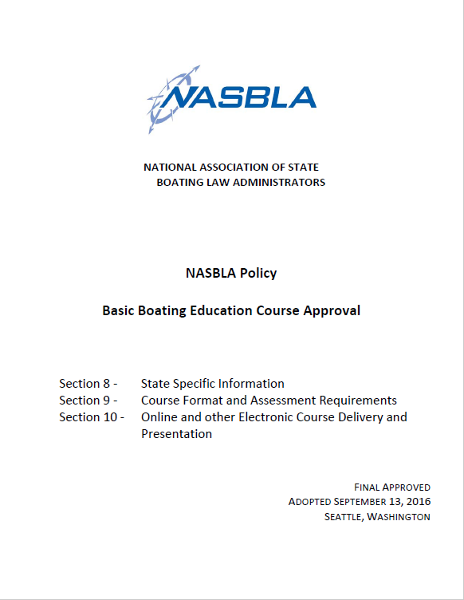
Available at www.nasbla.org/ Policy Revisions Approved September 13, 2016 Seattle, Washington
Notes:
Policy revisions approved in Seattle Washington on September 13, 2016. The Policy can be found @ www.nasbla.org

Slide 7
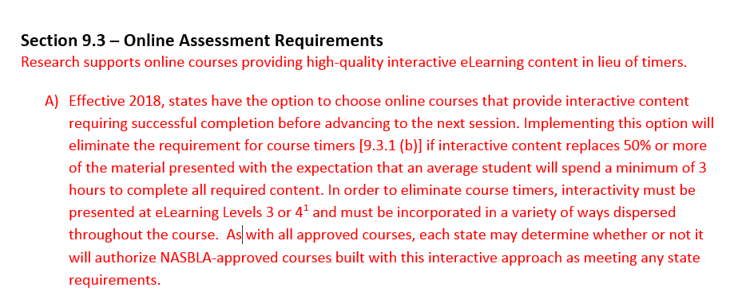
section 9.3A
INTERACTIVITY OPTION
Notes:
Section 9.3 Online Assessment Requirements reads….

Slide 8
section 9.3A
INTERACTIVITY OPTION
Consultant Selection Completed
Nearly 30 applicants considered
8 Interviewed by team of four
3 selected
Notes:
Project team reviewed 30 applications, interviewed 8 candidates & chose 3 consultants

Slide 9
Consultant agreements
PHASE 1– The rubric, with support and reference materials, shared with NASBLA project team to determine if the rubric is deemed acceptable/usable for the defined project.
3 individual separate concepts submitted for review- 1 from each consultant
Webinar presented on Jan 6, 2017 to Course Providers allowed for review/comments on the completed Consultant Concepts
Notes:
Consultants worked with the Project team and developed their own individual rubric. Project team thought each individual rubric had merit so all three were hired to develop the rubric. Webinar was presented so Course Providers were able to review/comment on the finished concepts.

Slide 10
CONSULTANT AGREEMENTS
PHASE 2 –Webinar survey input shared with CONSULTANTS to determine overall feasibility of the draft approaches.
Consultants merged/borrowed/revised and added information based on comments from Course Providers.
Completion of this phase 2 of work resulted in a single draft rubric which was presented to course providers on February 23, 2017 for comment.
Notes:
3 individual pieces of work created into 1 rubric based on comments from Course Providers. Then single draft again presented to Course providers for comment

Slide 11
CONSULTANT AGREEMENTS
Comments due March 9, 2017
Continued working with Consultants to finalize rubric
Early July posted final rubric and worksheets
Mid July posted tutorials
July 26th announced in NASBLA Weekly
Notes:
Comments due from Course Providers. Project team continued to work with Consultants and the final rubric & worksheets posted early July. Tutorials posted mid July. July 26th announced in NASBLA Weekly.

Slide 12
Rubric Development CONSULTANTS
May Chang, Instructional & Curriculum Designer. changm24@gmail.com
Gloryvee Cordero, Insta Apps LLC.
gloryvee@gmail.com
Houri Tamizifar, Founder, Cynuria Consulting. houri@cynuriaconsulting.com
Notes:
Our Rubric Development Consultants are…..

Slide 13
NASBLA eLearning Interactivity Design Rubric
Final rubric consisted of 4 Criteria
4 Criteria to be scored:
Learning Outcomes - 30%
Instructional Strategies - 30%
Multimedia Features - 20%
Practice and Feedback - 20%
Notes:
The final rubric consists of the following 4 Criteria. At this time, I would like to turn it over to Stacey Brown & Amanda Perez

Slide 14
NASBLA COURSE INTERACTIVITY Criteria 1 – Student Performance Objectives
Stacey Brown
Virginia Department of Game and Inland Fisheries

Slide 15
NASBLA Interactivity Criteria 1
NASBLA Approved Interactive Course
Student Performance Objectives
Practice and Feedback
Instructional Strategies
Multimedia Features
Student Performance Objectives
a.k.a. Learning Outcomes
Notes:
So – the first criteria to be evaluated to determine a course’s interactivity are whether or not the Student Performance Objectives (or learning outcomes) meet a defined measure of interactivity.

Slide 16
NASBLA Interactivity Criteria 1
What is a Student Performance Objective (SPO)?
Identify required knowledge
Already used in NASBLA course approvals
Correlate to ANSI Standards
Student Performance Objectives
Notes:
Student Performance Objectives (Also known as a learning objective) identify the information that will be presented to the student and information that the student is expected to learn in the course. All NASBLA approved courses already include student performance objectives during course review. The SPOs correlate to the ANSI Standards for Basic Boating Knowledge

Slide 17
NASBLA Interactivity Criteria 1
Why Interactive SPOs?
Retention, Retention, Retention…
Student Performance Objectives
Notes:
The NASBLA requirement for course interactivity requires that a certain percentage of Student Performance Objectives meet the defined interactive measure and also must prove that they are indeed interactive. Why the focus on interactivity? As e-learning and technology have changed over the years since internet courses were first developed, a lot of research has been done on effective e-learning. And what the research shows a student that participates in a course where memorization is the primary mechanism for learning and evaluation tends to retain less information than a student who actively participates in their learning and who is required to actually participate in class, rather than memorize and read, tends to retain more information. This is similar to what occurs in the classroom. Since a lot more research has been done in classroom learning styles, we are able to use models from the classroom and apply it to our internet courses. For the NASBLA interactivity review, we are utilizing the model provided by Bloom’s taxonomy to assist in the identification of interactivity in basic boating courses.
To meet the interactivity conditions for criteria 1, the SPOs need to be written to indicate that a student will be expected to learn the concepts at a higher knowledge level than just knowing or understanding. The SPOs will require that the student to be able to demonstrate that they know and understand the concept by applying their knowledge of basic boating in unique ways

Slide 18
NASBLA Interactivity Criteria 1
Notes:
If you are not familiar with Bloom’s Taxonomy – it is presented as a pyramid of cognitive development for students. It goes from the baseline of memory up to the peak – where a student actually creates new work

Slide 19
NASBLA Interactivity Criteria 1
apply
understand
remember
analyze
evaluate
create
Most content in interactive course
Level 4 Level 3 Level 2 Level 1
Most content in existing courses
Notes:
For our purposes – we have further divided Bloom’s taxonomy into 4 levels of learning. Most content in existing courses is presented at levels 1 and 2. Higher knowledge and retention by a student can be captured when that student completes course content at levels 3 and 4

Slide 20
NASBLA Interactivity Criteria 1
Student Performance Objective (SPO) in Interactive Courses
NASBLA Interactivity Measures
Bloom’s Taxonomy
Levels 3
Levels 4
Notes:
Again, to meet the definition of interactivity, a student performance objective must be written to fit into Bloom’s level of taxonomy higher levels of learning – levels 3 and 4 learning level that requires more complex learning than rote memory

Slide 21
NASBLA Interactivity Criteria 1
Level 1 Remember | Level 2 Understand | Level 3 Apply | Level 3 Analyze | Level 4 Evaluate | Level 4 Create
define, memorize, repeat, record, list, recall, name, collect, label, specify, cite, enumerate, recount | restate, summarize, discuss, describe, recognize, explain, express, identify, locate, report, review, translate | exhibit, solve, interview, simulate, apply, employ, use, demonstrate, practice, illustrate, calculate | interpret, classify, arrange, differentiate, group, compare, organize, examine, survey, categorize, dissect, probe, inventory, investigate, discover, distinguish, diagram, inspect | compose, plan, prepare, imagine, produce, incorporate, develop, design, originate, formulate, predict, contrive, assemble, construct, synthesize | judge, assess, measure, appraise, estimate, evaluate, infer, deduce, compare, score, value, choose, conclude, recommend, select, determine
Notes:
Each of the levels of interactivity are associated with certain words to help identify how the student will be expected to learn the material

Slide 22
NASBLA Interactivity Criteria 1
Student Performance Objective (SPO)
Define an “Actor”
Define Action Word or Behavior
Define Condition of the lesson
Measure Learning
Notes:
To create a student performance objective – each objective needs to include 4 parts

Slide 23
NASBLA Interactivity Criteria 1
Student Performance Objective (SPO)
Define an “Actor”
Define Action Word or Behavior
Define Condition of the lesson
Measure Learning
ANSI Standard - NASBLA 103-2016
Basic Boating Knowledge
Notes:
And again – each SPO relates to the ANSI Standard for Basic Boating Knowledge

Slide 24
NASBLA Interactivity Criteria 1
Sample SPOs for timed, non- interactive basic boating course:
ANSI Standard – NASBLA 103-2016
4.4 Aids to Navigation
Unit 4 – Safe Boat Operation
Lesson 4 – Aids to Navigation
Student Performance Objective:
Students will be able to describe the purpose of channel markers.
Notes:
This would be a sample SPO for a NASBLA course that would be classified at Bloom’s level 1 or 2.

Slide 25
NASBLA Interactivity Criteria 1
Student Performance Objective (SPO)
Define an “Actor”
Define Action Word or Behavior
Define Condition of the lesson
Measure Learning
ANSI Standard – NASBLA 103-2016
4.4 Aids to Navigation
Unit 4 – Safe Boat Operation
Lesson 4 – Aids to Navigation
Student Performance Objective:
Students will utilize an interactive scenario to learn to use navigation markers to navigate the correct path through a channel and differentiate between red and green lateral markers with 95% accuracy.
Notes:
this would be a sample SPO for a NASBLA course that would be classified at Bloom’s level 3 or 4.

Slide 26
NASBLA Interactivity Criteria 1
Sample SPOs for timed, non- interactive basic boating course:
ANSI Standard – NASBLA 103-2016
2.0 Boating Equipment
Unit 2 –Boating Equipment
Lesson 4 – Required Equipment
Student Performance Objective:
Students will be able to label required equipment for a powerboat.
Notes:
this would be a sample SPO for a NASBLA course that would be classified at Bloom’s level 1 or 2.

Slide 27
NASBLA Interactivity Criteria 1
Student Performance Objective (SPO)
Define an “Actor”
Define Action Word or Behavior
Define Condition of the lesson
Measure Learning
ANSI Standard – NASBLA 103-2016
4.4 Aids to Navigation
Unit 2 – Boating Equipment
Lesson 4 – Required Equipment
Student Performance Objective:
Students will utilize an interactive game to categorize the equipment for a power boat and a paddlecraft with 95% accuracy and predict potential dangers if equipment is not available.
Notes:
this would be a sample SPO for a NASBLA course that would be classified at Bloom’s level 3 or 4.

Slide 28
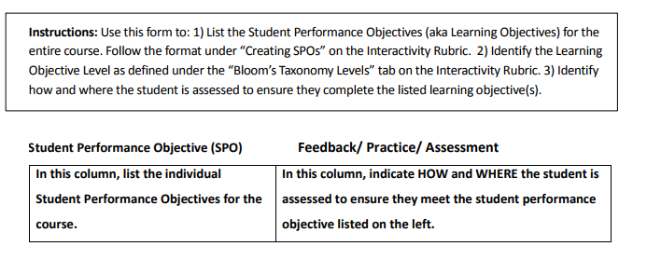
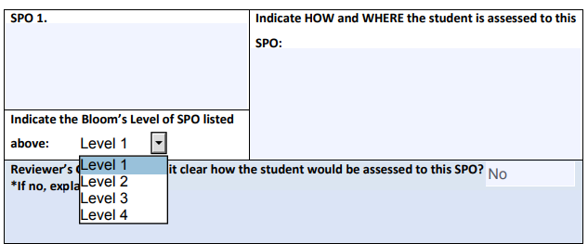
NASBLA Interactivity Criteria 1
SPO Worksheet
Criteria 1 and 4 Worksheet
Notes:
NASBLA has created 2 tools to help determine if a course meets the interactivity level for the Criteria 1

Slide 29
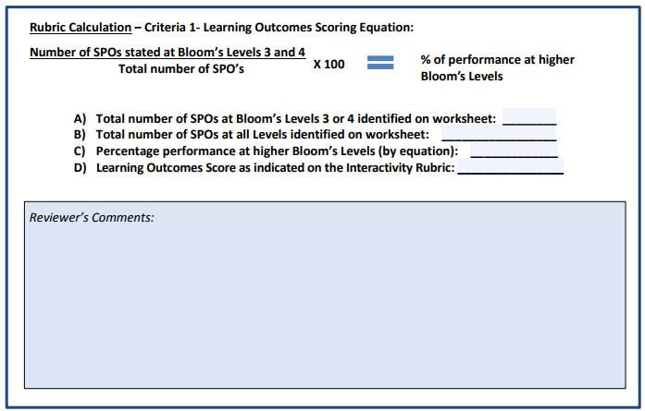
NASBLA Interactivity Criteria 1
SPO Worksheet
Criteria 1 and 4 Worksheet
Notes:
NASBLA has created 2 tools to help determine if a course meets the interactivity level for the Criteria 1

Slide 30
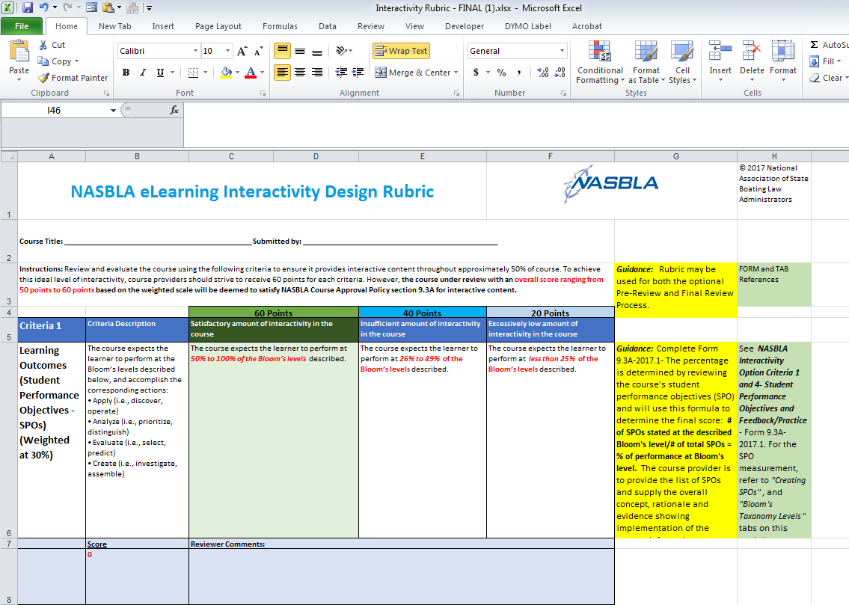
NASBLA Interactivity Criteria 1
SPO Worksheet
Design Rubric
Notes:
NASBLA has created 2 tools to help determine if a course meets the interactivity level for the Criteria 1

Slide 31
NASBLA Interactivity Criteria 1
Criteria 1 | Learning Outcomes (Student Performance Objectives -SPOs) (Weighted at 30%)
60 Points | Satisfactory amount of interactivity in the course | The course expects the learner to perform at 50% to 100% of the Bloom’s levels described.
40 Points | Insufficient amount of interactivity in the course | The course expects the learner to perform at 26% to 49% of the Bloom’s levels described.
20 Points | Excessively low amount of interactivity in the course | The course expects the learner to perform at less than 25% of the Bloom’s levels described.
SPO Worksheet
Design Rubric
Notes:
NASBLA has created 2 tools to help determine if a course meets the interactivity level for the Criteria 1

Slide 32
NASBLA Interactivity Criteria 1
NASBLA Approved Interactive Course
Student Performance Objectives
Practice and Feedback
Instructional Strategies
Multimedia Features
Notes:
So – the first criteria to be evaluated to determine a course’s interactivity are whether or not the Student Performance Objectives (or learning outcomes) meet a defined measure of interactivity.

Slide 33
Criteria 4 – Practice and Feedback
Amanda Pérez – BoatU.S. Foundation

Slide 34
Criteria 4
Practice & Feedback
Feedback and SPOs go hand in hand
More than just right or wrong
Lets the student know how they are doing
Reinforces concepts already learned
Can redirect misunderstood information

Slide 35
Criteria 4
Practice & Feedback
Incorrect!
What year did work begin on Mount Rushmore?
1914
1921
1927
1932

Slide 36
Notes:
What famous TV news anchor graduated from the University of South Dakota?
https://www.polleverywhere.com/multiple_choice_polls/BkWDLXj5E7oEwxj

Slide 37
Notes:
Whose faces are depicted on Mount Rushmore?
https://www.polleverywhere.com/multiple_choice_polls/Ee7O2E2EHTrThd3

Slide 38
Criteria 4
Practice & Feedback
The correct answer is C: George Washington, Thomas Jefferson, Theodore Roosevelt and Abraham Lincoln.
The sculptor chose these four presidents because he believed they represented the most important events in American history.

Slide 39
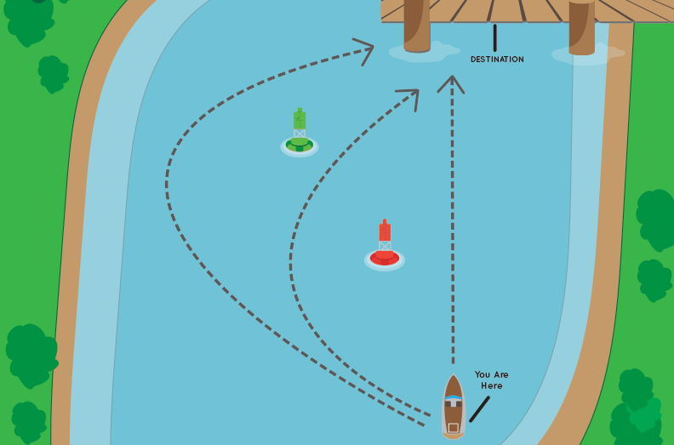
Criteria 4 - Feedback
Incorrect –
While it may seem the most direct route to your destination, by ignoring the red and green channel markers you’ll likely end up running aground.
Using what you just learned about red and green markers, choose the best route to get to the dock from where you are in this image.

Slide 40
Criteria 4 - Feedback
Correct –
When returning to port (or traveling upstream) always keep the red marker to the starboard side of your boat to stay in the channel and away from shallow water.
Using what you just learned about red and green markers, choose the best route to get to the dock from where you are in this image.

Slide 41
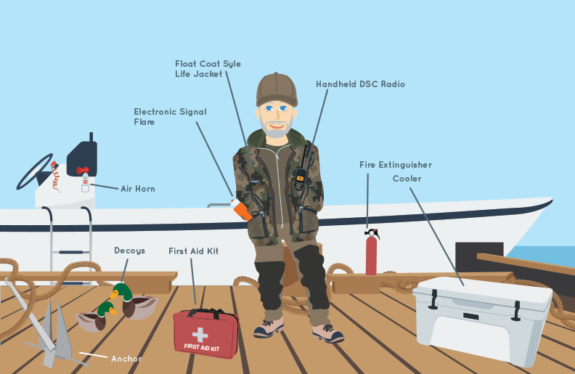
Criteria 4
Identify which of these items are federally required equipment for this hunter on his 16ft outboard boat.
A Subtitle (if used) here
Practice & Feedback
Incorrect –
While a handheld radio is an important piece of safety gear, especially for boaters heading out alone, it’s not required equipment for this boat.

Slide 42
Criteria 4
A Subtitle (if used) here
Practice & Feedback
Correct –
Not only is a life jacket required for every person on board, but in cold weather a float coat does double duty for floatation and warmth.

Slide 43
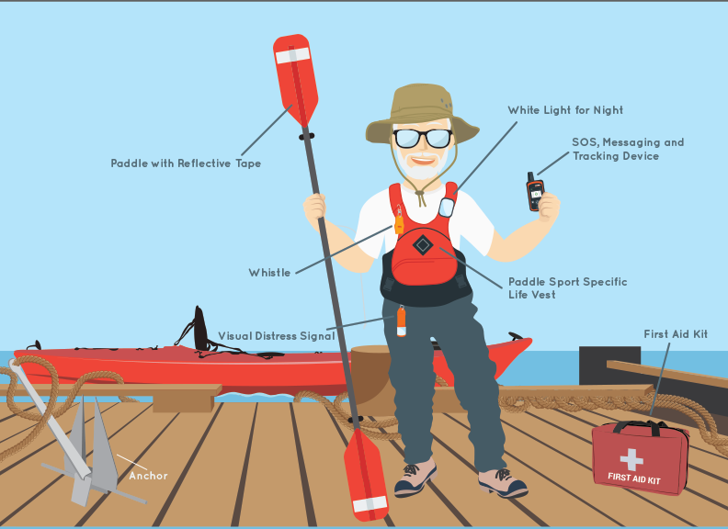
Criteria 4
Identify which of these items are federally required equipment for this paddler on his kayak.
Practice & Feedback
A Subtitle (if used) here
Incorrect –
While a first aid kit is important to be prepared for potential injuries, it is not federally required equipment.

Slide 44
Criteria 4
Practice & Feedback
A Subtitle (if used) here
Correct–
A sound producing device, such as a whistle, is required equipment. It’s important so you can signal others on the water.

Slide 45
Criteria 4
Practice & Feedback
The main text goes here. It can be presented in paragraph form like this, or, it can also be bulleted like the following text:
Bulleted text provides emphasis.
And breaks information into sizable chunks.
It helps guide people step-by-step through complex ideas.
You can use as few or as many as you need,
But please...
Do not add any text below this line.

Slide 46
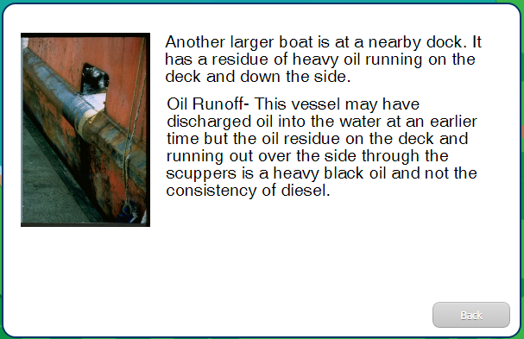
Criteria 4
Practice & Feedback
The main text goes here. It can be presented in paragraph form like this, or, it can also be bulleted like the following text:
Bulleted text provides emphasis.
And breaks information into sizable chunks.
It helps guide people step-by-step through complex ideas.
You can use as few or as many as you need,
But please...
Do not add any text below this line.
This is not the source of the spill.

Slide 47
Criteria 4 - Feedback
A Subtitle (if used) here
The main text goes here. It can be presented in paragraph form like this, or, it can also be bulleted like the following text:
Bulleted text provides emphasis.
And breaks information into sizable chunks.
It helps guide people step-by-step through complex ideas.
You can use as few or as many as you need,
But please...
Do not add any text below this line.
This IS the source of the spill.

Slide 48
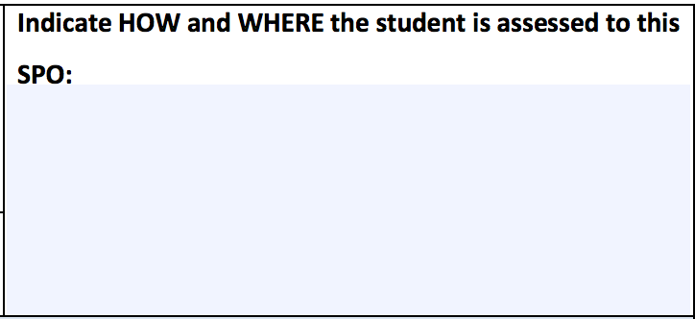
Criteria 4
Practice & Feedback
NASBLA has provided a form that covers criteria 1 and 4.
In exercise 4b the student will evaluate the navigation scenario presented with red and green lateral markers and, using what they have learned about lateral markers, chose a path from 3 options to get to the designated destination.

Slide 49
Criteria 4
Practice &
Feedback
Criteria for Evaluation:
The total number of decision points
Feedback provided
Assessment clarity

Slide 50
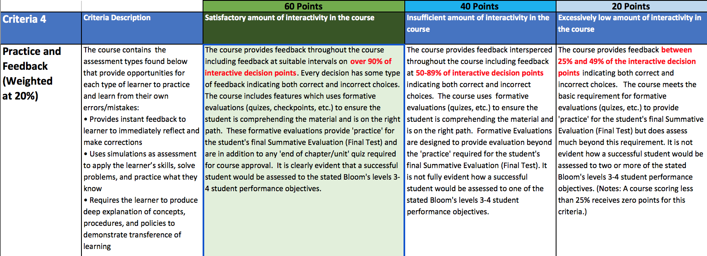
Criteria 4
Practice & Feedback
Criteria 4 Grading: weighted 20%
60 points: 90% decision points include feedback
40 points: 50 – 89% decision points include feedback
20 points: 25 – 49% decision points include feedback

Slide 51
Criteria 4
Practice & Feedback
Who was that famous news anchor that graduated from the University of South Dakota?

Slide 52
Criteria 4
Practice & Feedback
D

Slide 53
criteria two
INSTRUCTIONAL STRATEGIES
Notes:
3 parts

Slide 54
INSTRUCTIONAL STRATEGIES
real-life scenarios
explore, search, investigate
long-term memory

Slide 55
REAL-LIFE SCENARIOS
What is the best way to teach someone how to boat?
Take them boating.
Notes:
people love stories

Slide 56
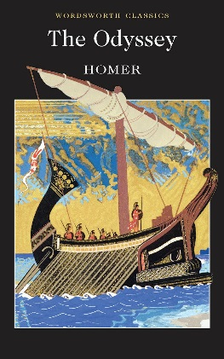
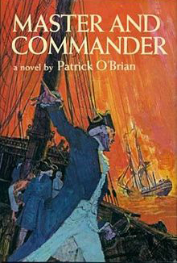
REAL-LIFE SCENARIOS
stories
People love stories.
Especially the ones with boats.

Slide 57
REAL-LIFE SCENARIOS
stories
“
You’re gonna need a bigger boat.”

Slide 59
FIVE VARIATIONS
contextual learning
ARC Learning as part of the core story arc
REMOVED Learning one level removed from story action
HINTS Learning suggestions, cues, and hints
LEARNING Remedial learning
LIBRARY Entire NASBLA core topic library always available

Slide 60
EXPLORE, SEARCH, AND INVESTIGATE
catalysts
HIGH
BOATING
EXPERIENCE
MEDIUM-HIGH
BOATING
EXPERIENCE
MEDIUM-LOW
BOATING
EXPERIENCE
LOW
BOATING
EXPERIENCE

Slide 61
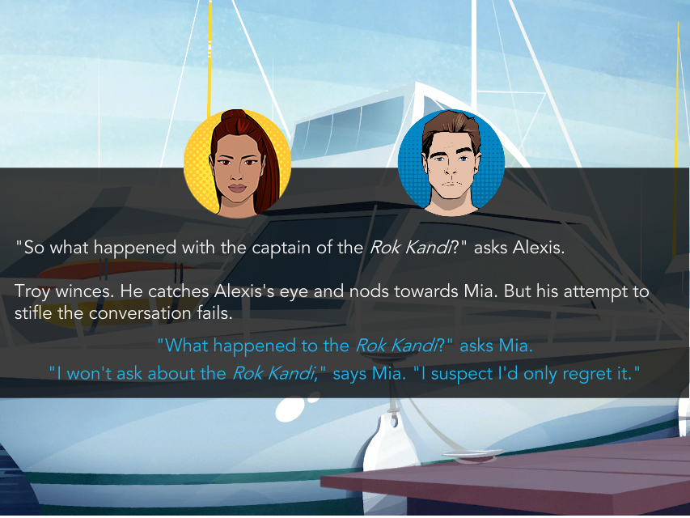

Slide 62
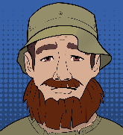
CHARACTERS DRIVE THE ACTION AND LEARNING

Slide 63
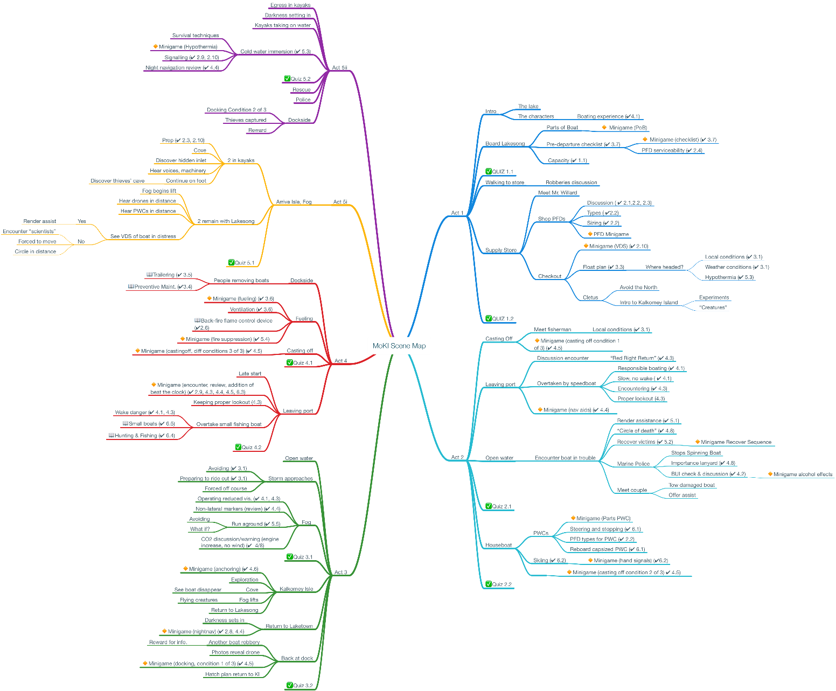
EVERY STANDARD COVERED
mind map

Slide 64
CHALLENGING AND RELEVANT
skin in the game
Why do we borrow from existing online game design?
Operant Conditioning (Rewards and Punishments)
story
level up
achievements
Notes:
1. IF - interactive fiction
2. “Leveling up”
3. Earning achievement and rewards

Slide 65
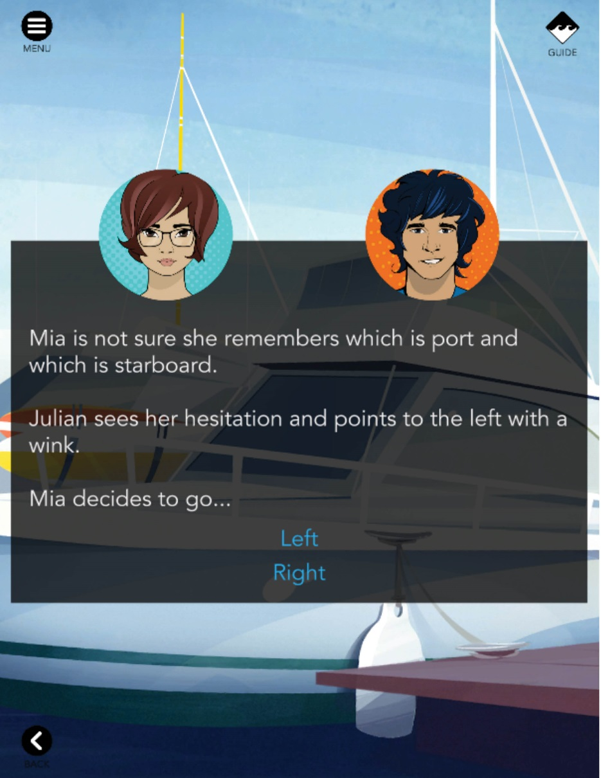
EXPLORE, SEARCH, AND INVESTIGATE
fiction

Slide 66
EXPLORE, SEARCH, AND INVESTIGATE
activities

Slide 67
EXPLORE, SEARCH, AND INVESTIGATE
activities

Slide 68
EXPLORE, SEARCH, AND INVESTIGATE
activities
Emergency Preparation
Emergency Preparation
Emergency Preparation
Emergency Preparation
Emergency Preparation
Emergency Preparation
Notes:
various safety topics go in the narritive

Slide 69
EXPLORE, SEARCH, AND INVESTIGATE
rewards
The Boat
Boating
Equipment
Trip Planning
Safe Boating
Operation
Emergency Preparation
Water
Activities
The Mystery
Notes:
ties to mystery

Slide 70
EXPLORE, SEARCH, AND INVESTIGATE
rewards

Slide 71
USER TESTING
engagement
30–40 minute sessions
46 PARTICIPANTS
across the USA
male and female
“average” computer experience
various ages

Slide 72
USER TESTING
exploration
“not boring and bland”
“retain a lot of knowledge”
“really commit these things to memory”

Slide 73
USER TESTING
learning
“I feel like I will be better prepared for when I do go out on a boat.”

Slide 74
USER TESTING
relevance
“You’ll be able to learn this in a fun way.”

Slide 75
Prototype available for demo now
NASBLA approval begins in October
Planned release date January 2018

