Slide 1
States Organization for Boating Access Annual Meeting – August 30, 2022

Slide 2
Agenda
Introduce myself and AMI
Discuss briefly AMI’s strategic focus areas:
Conference
Training
Data Industry Trends
Advocacy
Clean and Resilient Marina Program

Slide 3
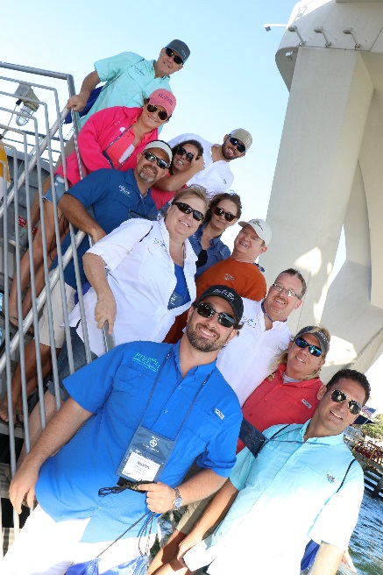
Title
Network with over 900 marina industry peers
Over 150 exhibits - one-stop marina shop for all your marina needs
Five Tracks
1) Transforming Your Organization – Evolving the Mindset for Positive Impact
2) Building Your Dream Team
3) Understanding Key Performance Indicators
4) Marina & Boatyard Operations & Management
5) Design & Engineering
Marina and Boatyard ½ day Tour
Pre-conference training and workshops –
Marina 101
Marina Electrical Design
Marina Design
Clean Marina

Slide 4
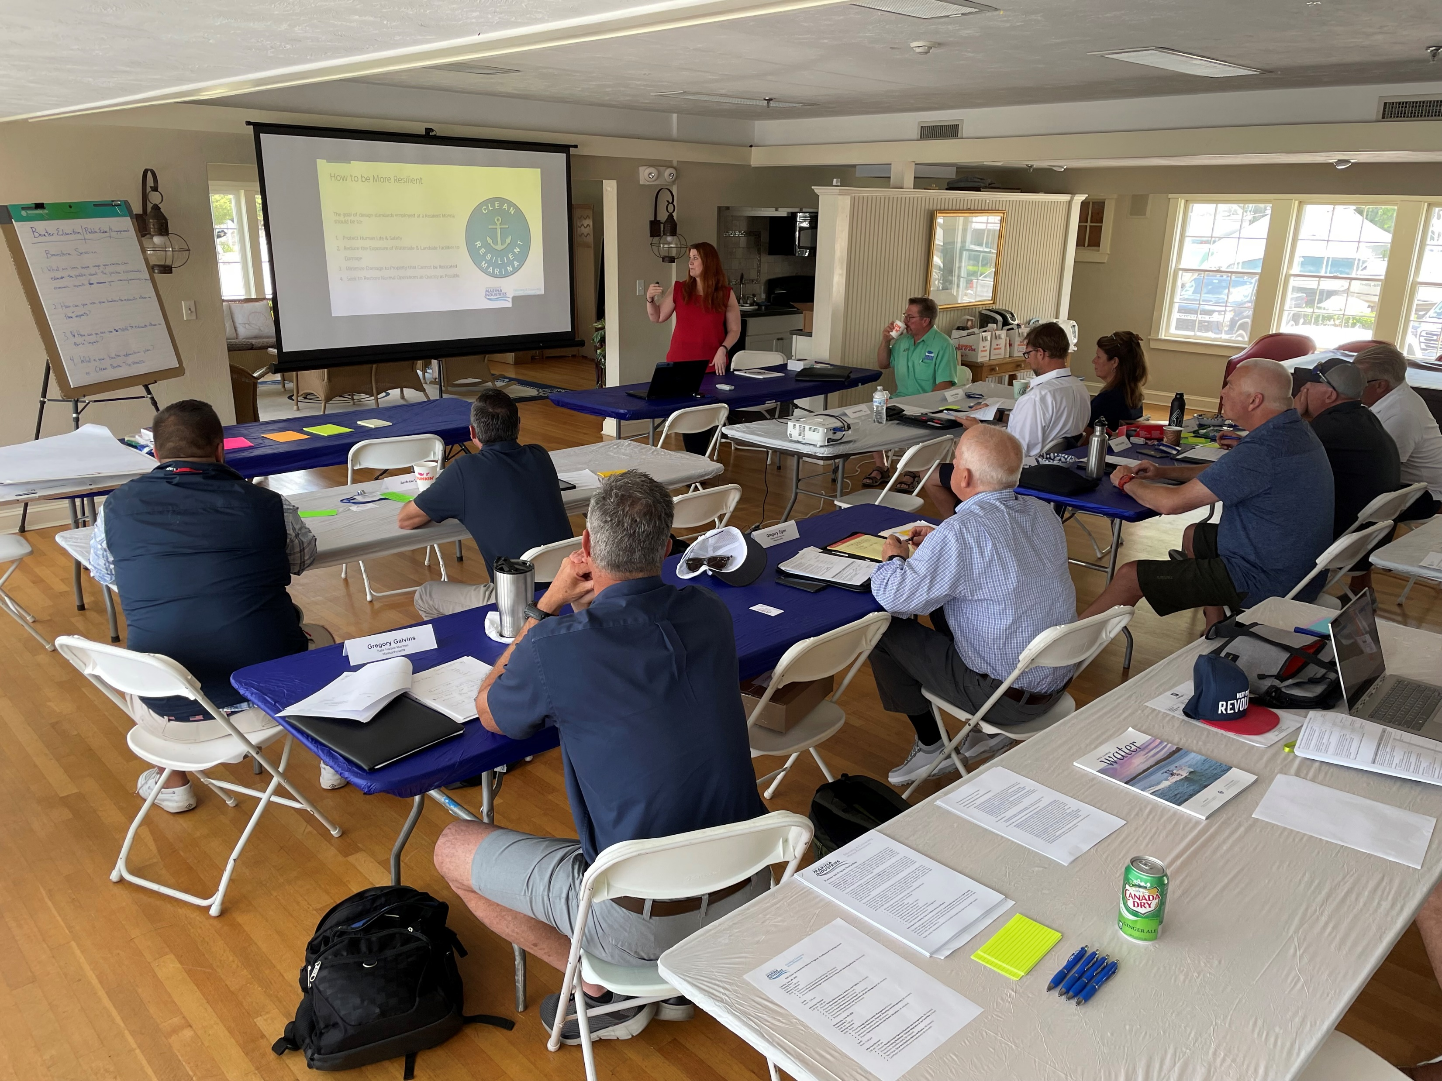
Training and Education
AMI’s Training Institute (formerly International Marina Institute) provides training, education, and certification opportunities to marina employees, from dockhands to managers.
Building “Graduate Level” courses that will provide training in specific areas – example: Clean and Resilient Marina Training Course.
Our upcoming training opportunities:
Intermediate Marina Management Course: Virtual - Sept. 7 - 29, 2022
Waste Reduction, Disposal, and Recycling (Webinar) - Sept. 7, 2022
Advanced Marina Management School - Oct. 16 - 21, 2022
Marina and Boatyard Study Tour - October 24 - 25, 2022
Clean and Resilient Marina Course – TBD
Intermediate Marina Management Course - Oct. 30 - Nov. 3, 2022
Advanced Marina Management School - Dec. 4 - 9, 2022

Slide 5
Data & Industry Trends
AMI creates reports specific to the marina and boatyard industry
Gathering data from our 1000 marina business membership
We also maintain a Marina Economic Impact Calculator
Some of our surveys:
Marine Rates and Infrastructure Reports
Economic Outlook Reports
Wage Rate Reports
Marine Economic Impact

Slide 6
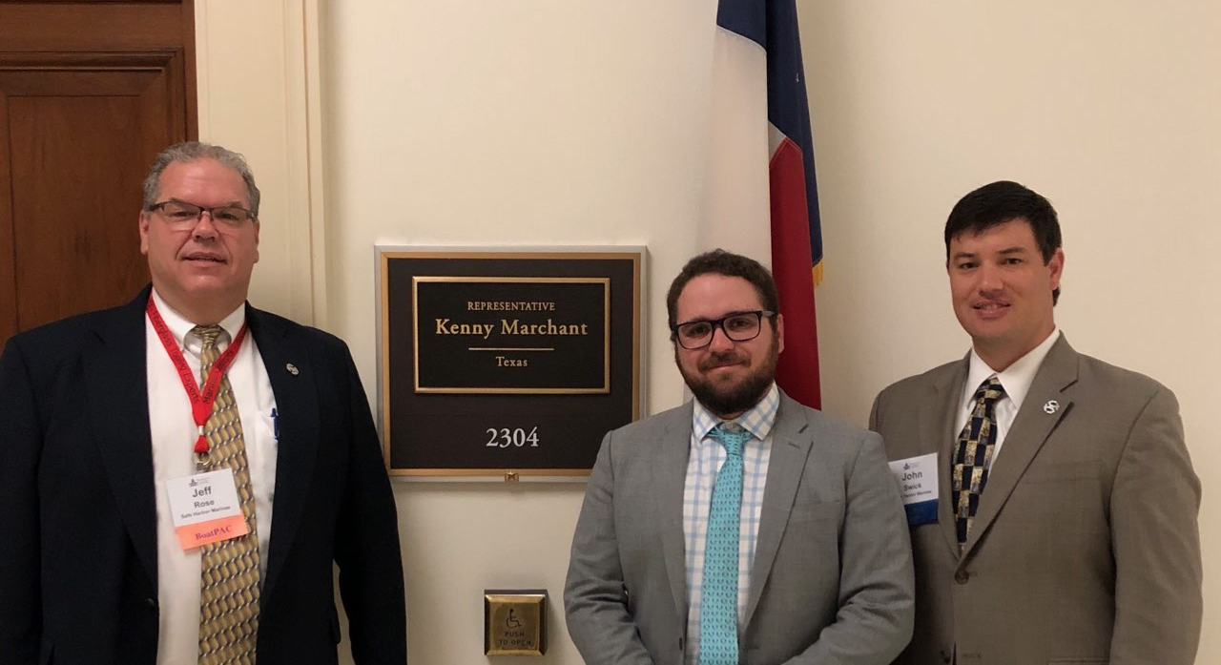
Advocacy
AMI works with industry partners to advance legislation in support of the boating industry
Areas of interest are environment, boating safety, green and blue infrastructure, disaster mitigation and preparedness, electrification, among others.
Over the years we have been involved in:
Boating Infrastructure Grant and Clean Vessel Act Reauthorization
Water Resources Development Act
Coast Guard Reauthorization
PREPARE Act

Slide 7
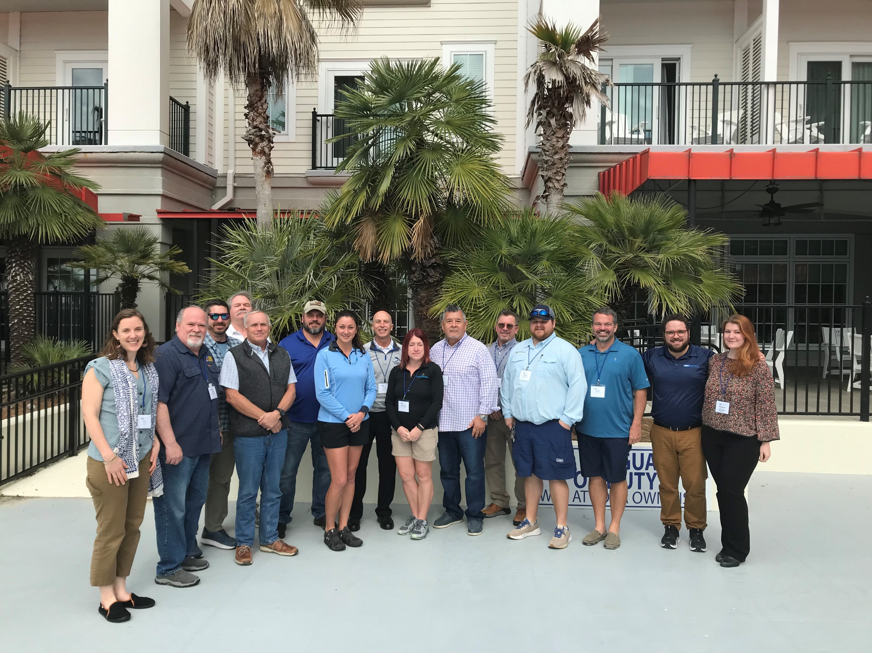
Clean and Resilient Marina Program
In 2021, AMI launched the development of a Clean and Resilient Marina
Goals –
To provide marina professionals training in clean and resilient marina best management practices
To fill gaps in existing clean marina programs to expand access to marina facility certification
To raise awareness of clean marina practices as best management practices at marinas period.
Where are we today:
We have a complete curriculum, training, agenda, guidebook, and checklist
We have held three training workshops – South Carolina, Minnesota, Massachusetts
Trained 35 Clean Marina Professionals
Plan to verify as Clean and Resilient at least 20 marinas this year.

Slide 8
THANK YOU
Insert Image
Eric Kretsch – Ekretsch@MarinaAssociation.org – (202)-350-9623

